Slide 1
When and How Long Questions
Basic 3

Slide 2
Relative pronouns with prepositions
When is the party?
It is in July.
It starts at 1
It is in October.
It starts on October 3rd at 10 in the morning
When is the festival?

Slide 3
Relative pronouns with prepositions
How long is the party?
It is from 6 to midnight.
It is until midnight.
It is from October 3rd to October 12th.
It is from October 3rd until October 12th.
It lasts for nine days
How long is the festival?

Slide 4
Relative pronouns with prepositions
When do you study
I study in the afternoons.
I study at 1.
When do you study?
I study on Saturday.
I study after school

Slide 5
Relative pronouns with prepositions
How long do you sleep?
I sleep from midnight to 5:30 in the morning.
I sleep until noon on the weekend.
I exercise from 8 to 10 at night
I exercise until 10 at night.
I exercise for 2 hours
How long do you exercise?

Slide 6
5-2 PREPOSITIONS OF TIME
How long do you work?
I work from 9:00 to 5:00.
from (a time) to (a time)

Slide 7
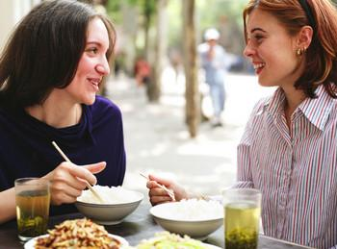
3-12 Let’s Practice
It is at 7:00 from Monday to Friday.
When is the class
______________?

Slide 8
3-12 Let’s Practice
I work on Saturday from 3:00 to 8:00
When do you work?

Slide 9
3-12 Let’s Practice
It is from 7:00 to 8:30
How long is the class?

Slide 10
3-12 Let’s Practice
I work from 3:00 to 8:00
How long do you work?
I work for five hours

Slide 11
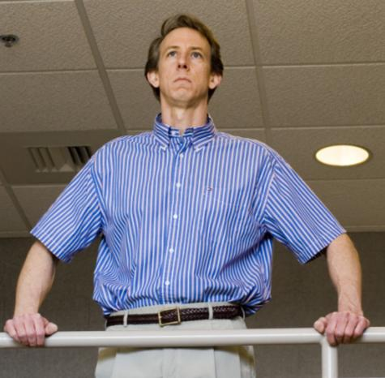
5-2 Let’s Practice
at in on from ... to
from
I work ____ 8:30 A.M.
__ 4:30 P.M.
to

Slide 12
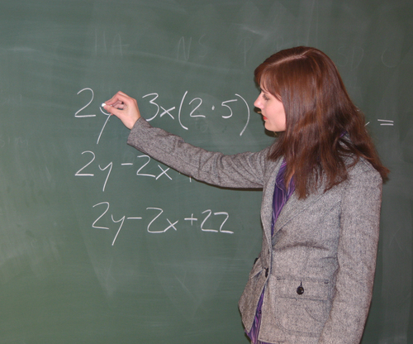
5-2 Let’s Practice
at for on from ... to
I teach a class __ 8:30 A.M. __ Monday.
at
on

Slide 13
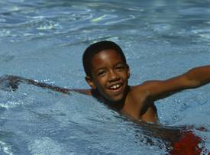
5-2 Let’s Practice
at in on for
He swims __ the afternoon.
in

Slide 14
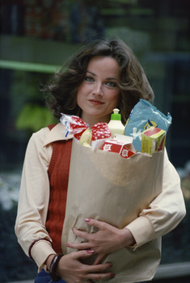
3-12 THE SIMPLE PRESENT: ASKING INFORMATION
QUESTIONS WITH WHEN AND WHAT TIME
at in on for
in
She goes shopping __ the afternoon. She goes shopping ___ 3 hours ☺
for

Slide 15
3-12 THE SIMPLE PRESENT: ASKING INFORMATION
QUESTIONS WITH WHEN AND HOW LONG
Q-WORD + BE + SUBJECT + EVENT
(am/is/are)
(a) When is your exam?
It is at 7:00.
(b) How long is your exam?
It is from 7:45 to 8:30.
It last for 45 minutes.

Slide 16
Q-WORD + BE + SUBJECT + EVENT
(am/is/are)
(a) When is your class?
It is at 7:00.
(b) How long is your class?
It is from 7:00 to 8:30.

Slide 17
Q-WORD + DO/ + EVENT + LAST?
DOES
(b) How long does your exam last?
It lasts for 45 minutes
It is 45 minutes long

Slide 18
Q-WORD + DO/ + SUBJECT + MAIN
DOES VERB
(a) When do you work?
I work at eight o’clock.
(b) How long do you work?
I work from noon to six.

Slide 19
Q-WORD + DO/ + SUBJECT + MAIN
DOES VERB
(a) When does he work?
he works at eight o’clock.
(b) How long does he work?
He works from noon to six.

